Slide 1
Advertising media Analtyics 4
File created on: 5/2/2025 5:04:32 PM

Slide 2
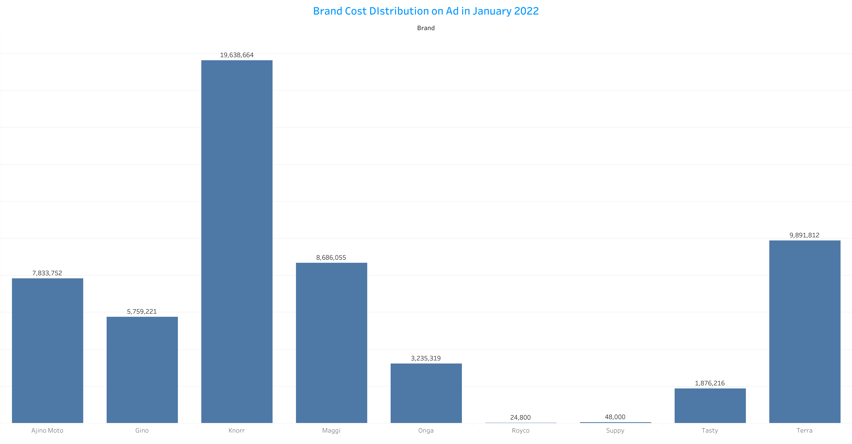

Slide 3
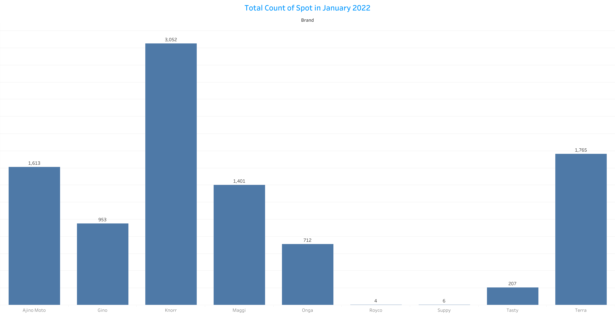

Slide 4


Slide 5


Slide 6
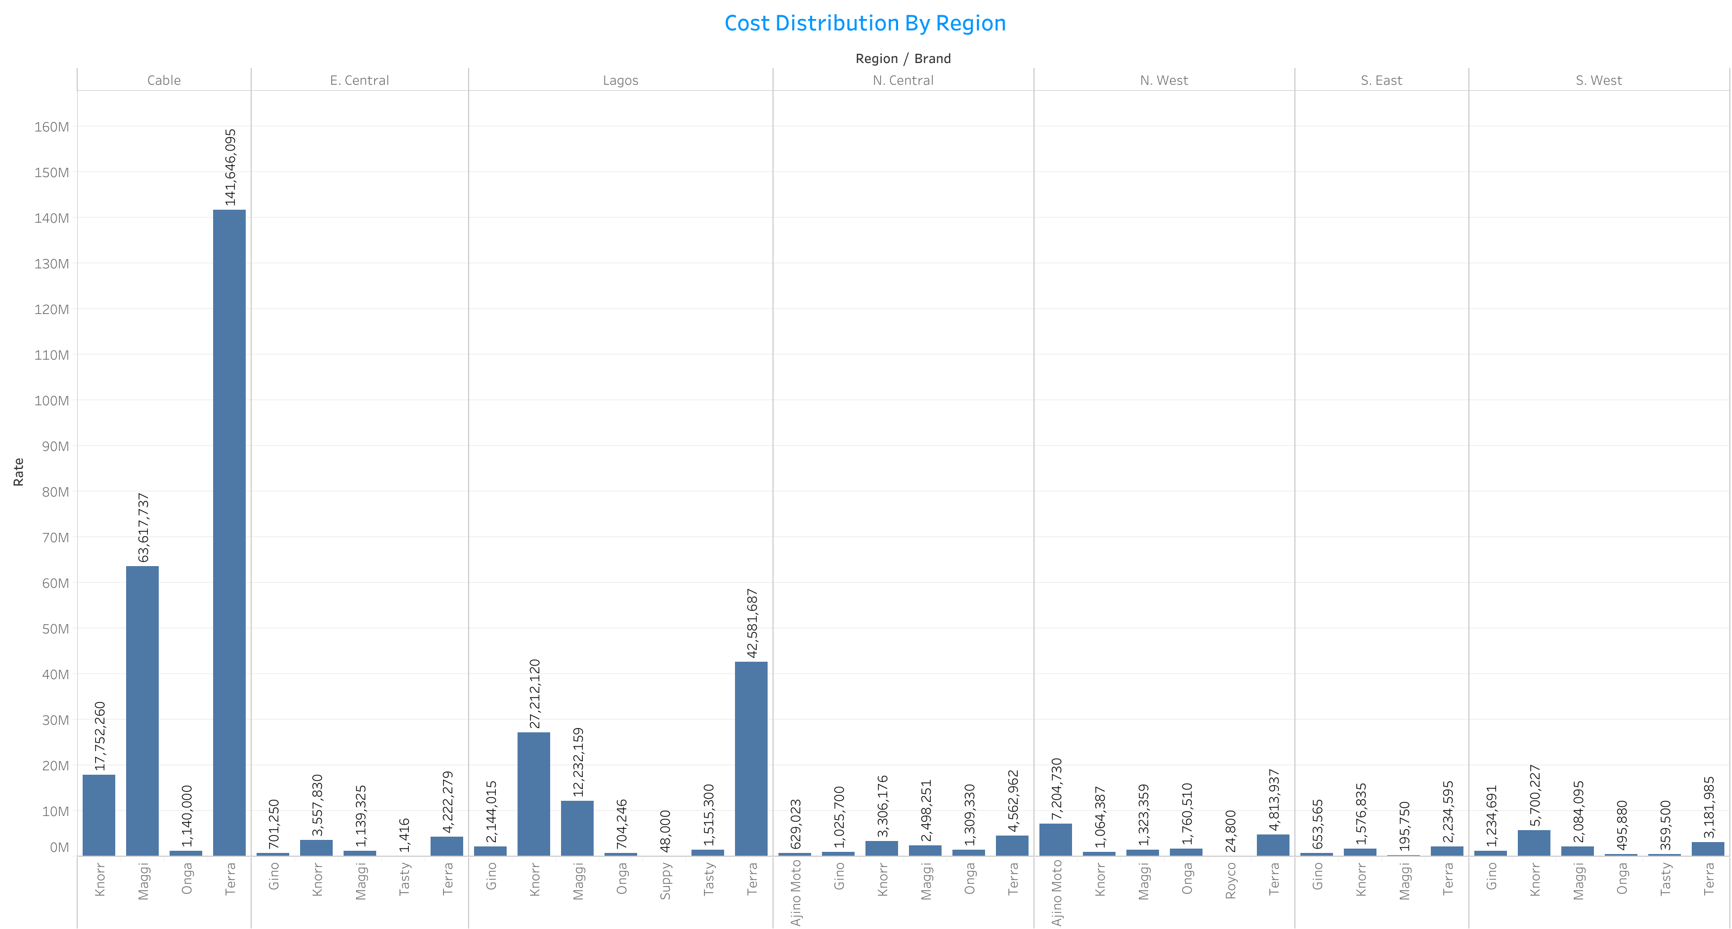

Slide 7


Slide 8


Slide 9


Slide 10
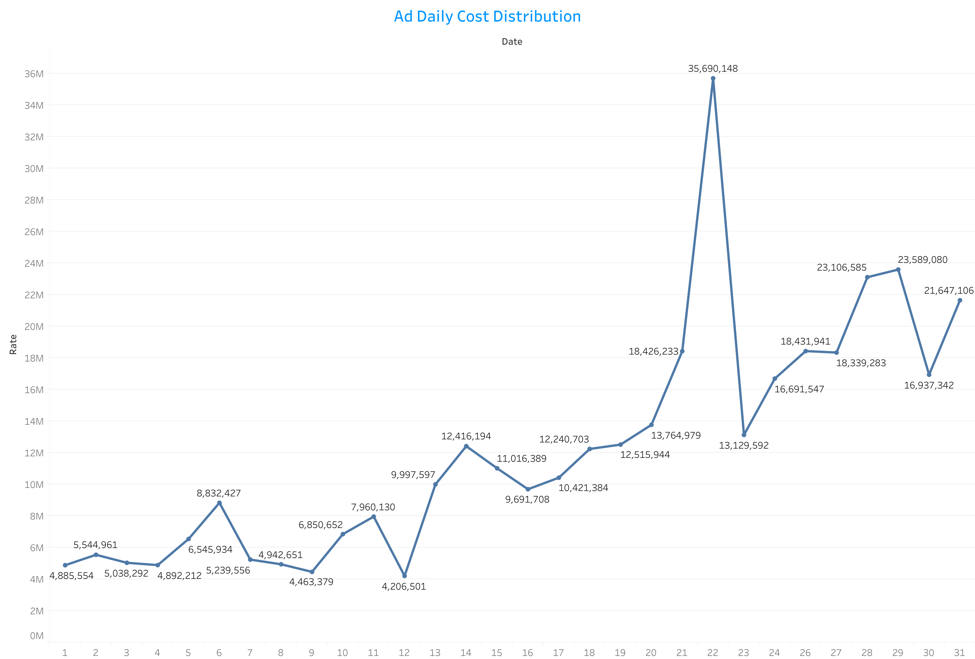

Slide 11
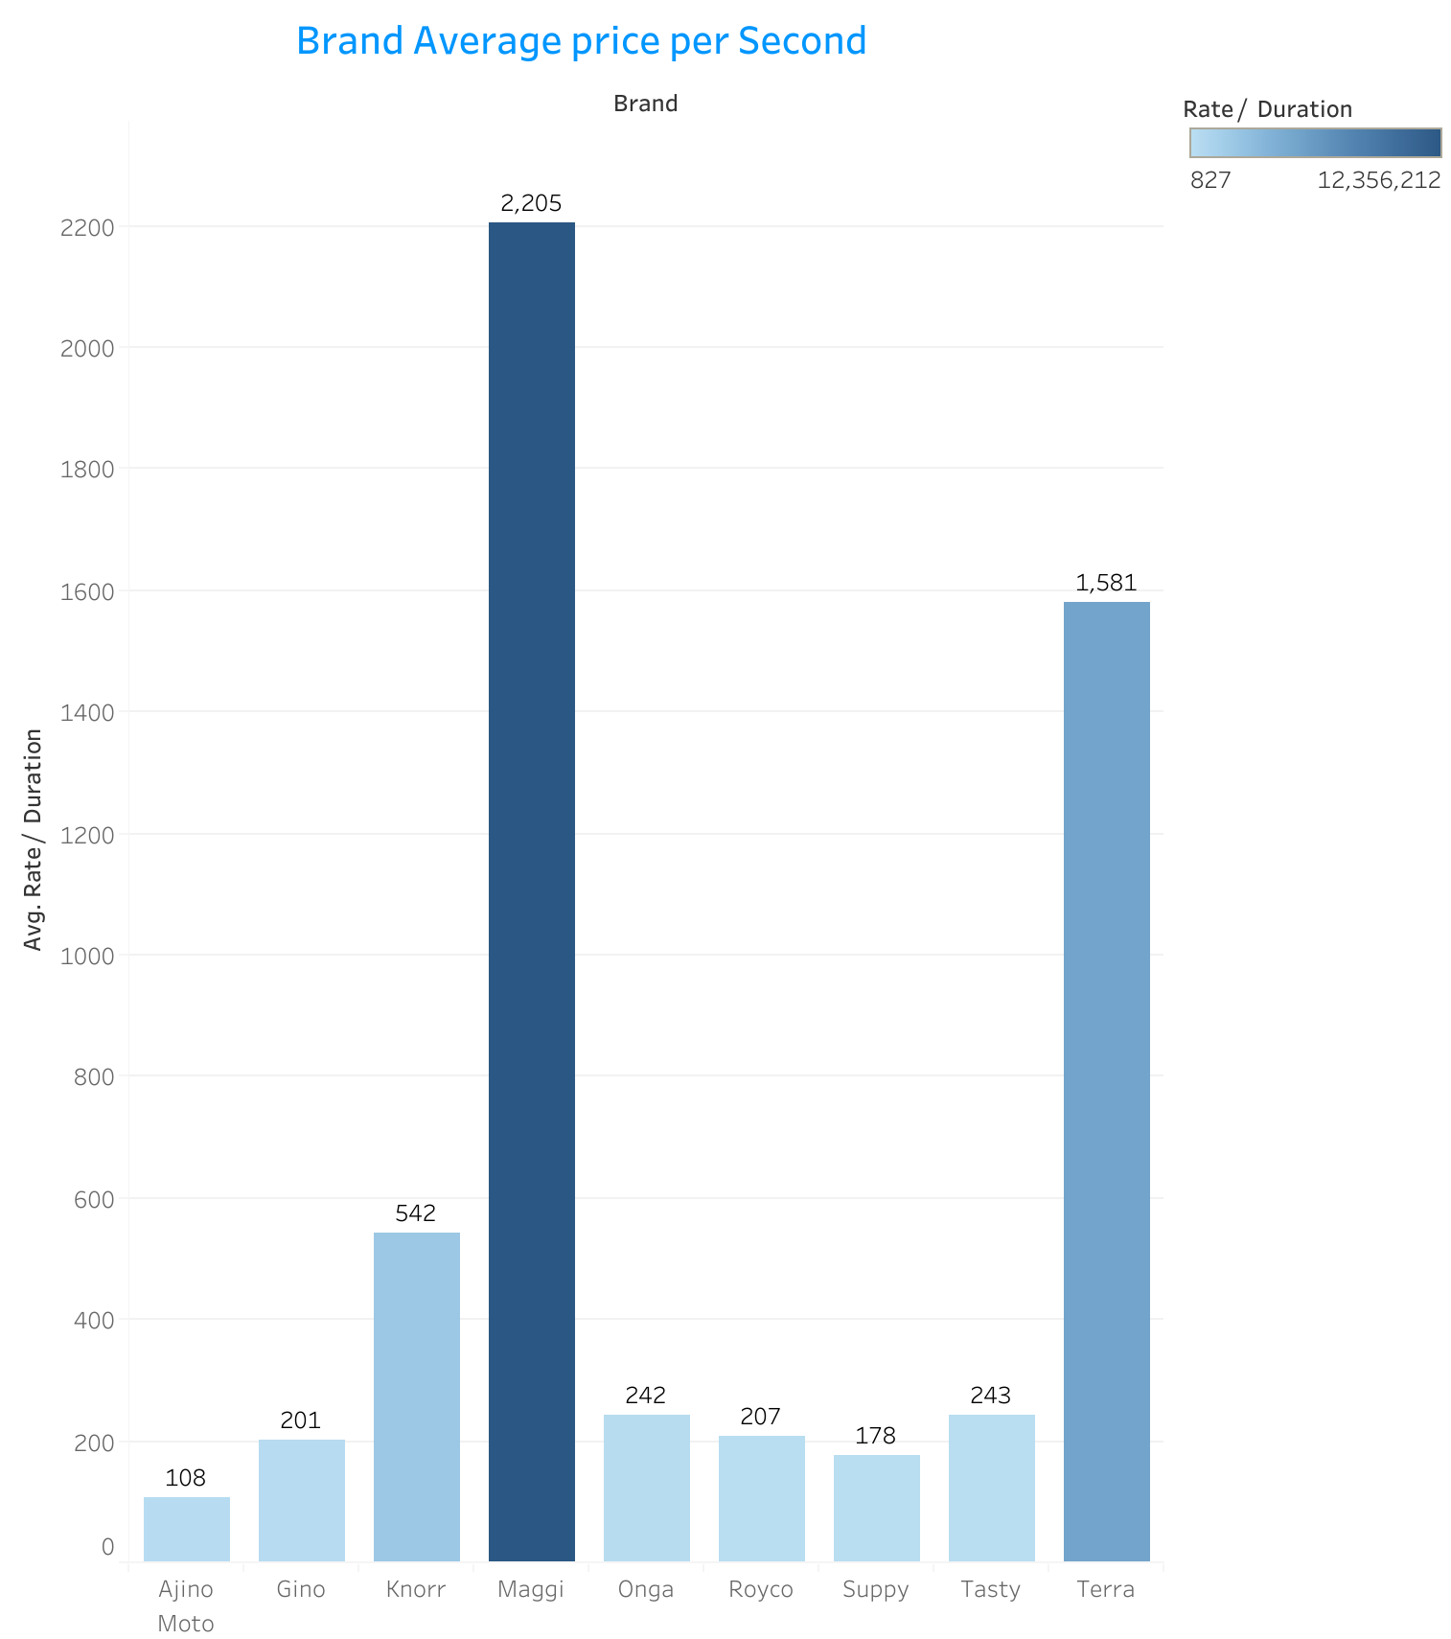

Slide 12


Slide 13


Slide 14
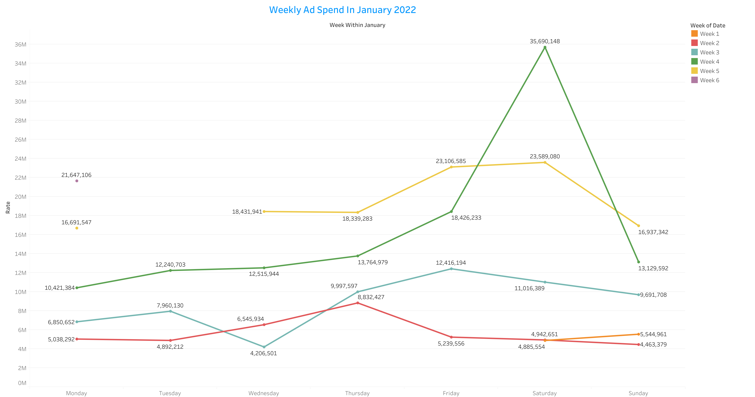

Slide 15


Slide 16


